Slide 1
Pushdown Automata
By: - Aditya Goswami Ashutosh Kumar Bharti Himanshu Kumar Kalpak Bagi

Slide 2
CONTENTS
Introduction
Formal definition of PDA
Components of PDA
PDA Acceptance
Example (Given language)
Transition functions
Transition state diagram
Conclusion

Slide 3
Introduction
Pushdown automata is a way to implement a CFG.
PDA can remember an infinite amount of information.
PDA is simply an NFA augmented with an "external stack memory". PDA can store an unbounded amount of information on the stack.
A PDA is more powerful than Finite Automata. As PDA accepts class of languages which cannot be accepted by FA. Thus PDA is more superior to FA.

Slide 4
Formal Definition of PDA
Pushdown Automata is defined by 7 tuples : (Q,∑, δ,q₀,z,F, Γ)
Q is the set of states
∑ is the set of input symbols
Γ is the set of stack symbol
q₀ is the initial state
z is the initial stack symbol
F is the set of final states
δ is a transition function (Q x {Σ ∪ ∈} x Γ = Q x Γ*)

Slide 5
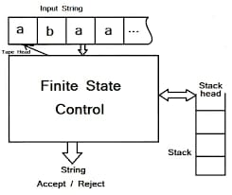
Components of PDA

Slide 6
Components of PDA
Input tape: The input tape is divided in many cells or symbols. The input head is read-only and may only move from left to right, one symbol at a time.
Finite control: It has some pointer which points the current symbol which is to be read.
Stack: The stack is a structure in which we can push and remove the items from one end only. It has an infinite size. In PDA, the stack is used to store the items temporarily.

Slide 7
PDA Acceptance
A language can be accepted by Pushdown automata using two approaches:
Acceptance by Final State: The PDA is said to accept its input by the final state if it enters any final state in zero or more moves after reading the entire input.
Acceptance by Empty Stack: On reading the input string from the initial configuration for some PDA, the stack of PDA gets empty.

Slide 8
Example
Design and implement Pushdown Automata for language given below
L = {a^n b^2n for n>=1}
L= { abb, aabbbb, aaabbbbbb,...}

Slide 9
Solution
7 tuples for given language
Q={q_{0,} q_{1,} q_{2,} q_{f} }
∑={ a, b}
Γ ={ z, a, b}
Initial stack symbol = z
Initial state = q₀
Final state = q_{f} δ

Slide 10
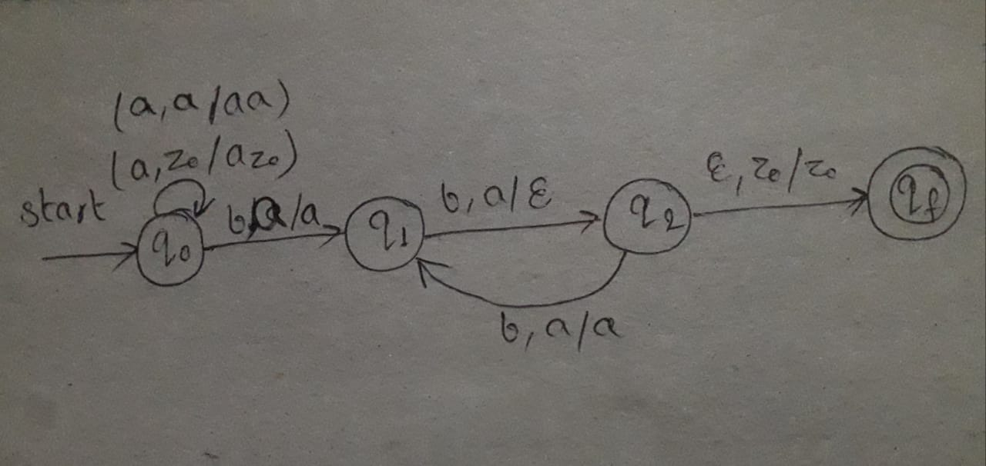
Transition Diagram

Slide 11
Transition Functions
δ(q₀, a ,z)=(q₀, az)
δ(q₀, a, a)=(q₀, aa)
δ(q₀, b, a)=(q₁, a)
δ(q₁, b, a)=(q₂, ε)
δ(q₂, b, a)=(q₁, a)
δ(q₂, ε, z)=(q_{f}, z)

Slide 12
Conclusion
We learnt about
Pushdown Automata.
7 tuples of PDA.
Transition function and diagram for given language.
Hence at the end, stack becomes empty we say that given language is accepted by PDA.

Slide 13
Thank You

